Slide 1
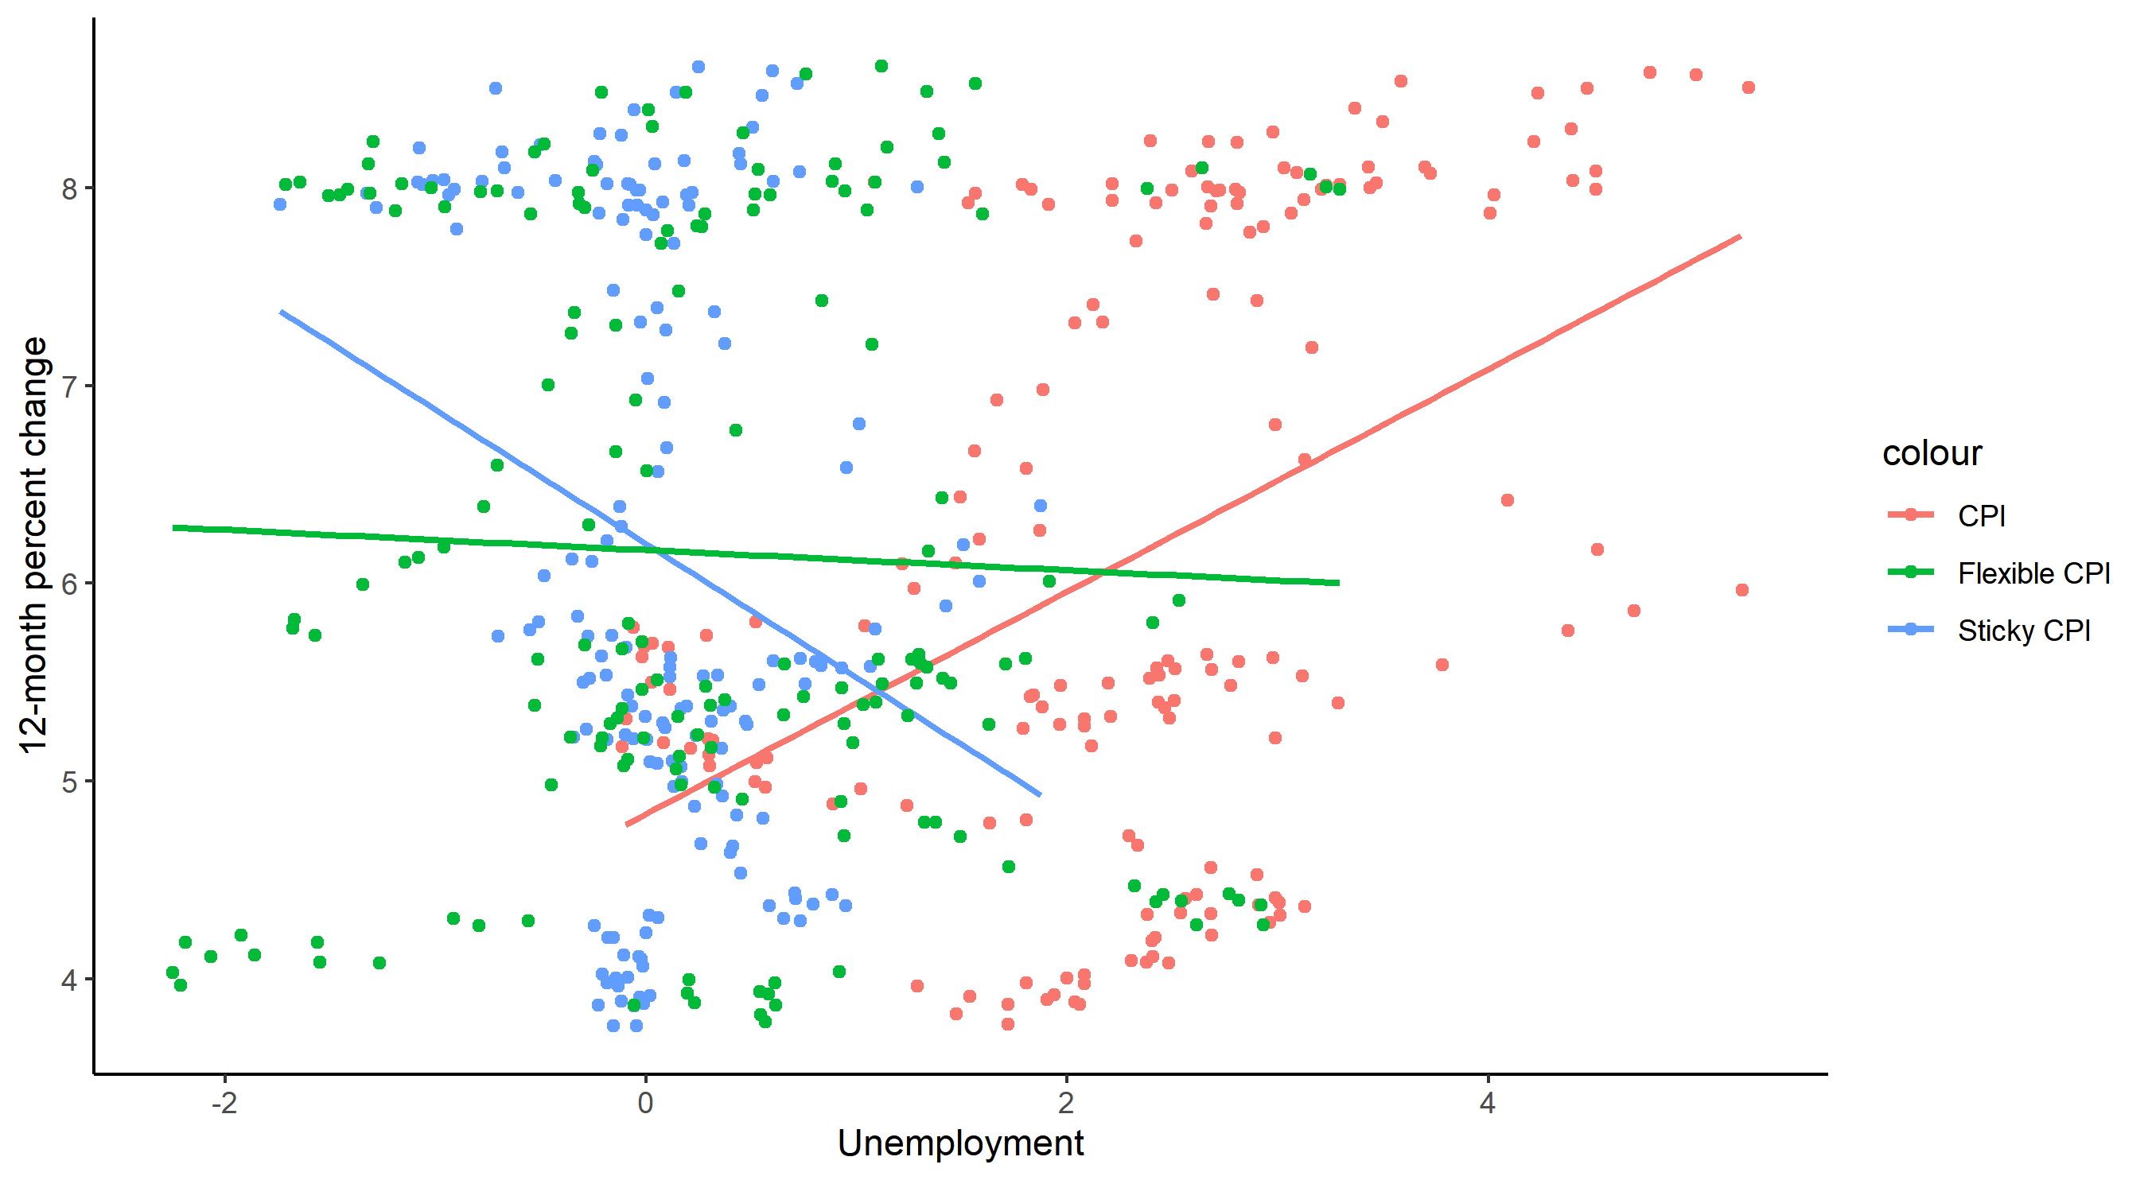

Slide 2
8
7
colour
12-month percent change
CPI
6
Flexible CPI
Sticky CPI
5
4
-2
0
2
4
Unemployment

